Slide 1


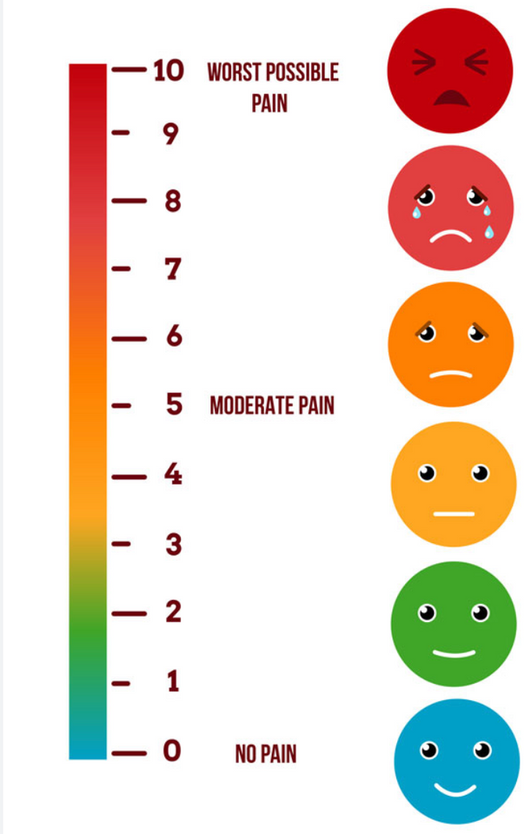
Pain Level Communicator
Microcontroller-based Assistive Device
Group: Navdisha Bhakri & Dhruv Chotalia (Group 16)

Slide 2




The Problem
Many patients (stroke, ALS, intubated, mobility-restricted) cannot verbally express pain.
Traditional tools (e.g., Wong-Baker FACES) require a nurse to be physically present.
This causes delayed treatment, delayed analgesic administration, and patient discomfort.

Slide 3

Background Research
Existing Solutions & Their Limitations
Key Points:
13% of Canadian adults have mobility or communication disabilities.
Current tools fall into two categories:
Call Bell Systems: simple ON/OFF, no detail.
Bedside Tablets: high detail but require fine motor control.
Gap: No device with simple interface + detailed pain information.

Slide 4

How We Came Up With the Solution ?
Research Insight: Existing tools are either too simple (call bell) or too complex (tablets).
Accessibility Requirement: Many patients (ALS, stroke, intubated) can press one button but cannot navigate screens.
Design Decision: Chose single-button input with 5 pain levels because it works for patients with limited mobility.
Instant Feedback Need: Selected RGB LED because it delivers fast, intuitive color confirmation (Green → Yellow → Red).
Nurse Interaction Gap:
→ Added two-way UART so nurses can acknowledge or respond (A).
Performance Requirement:
→ LED driver written in Assembly to guarantee zero-latency updates.
Testing Feedback:
→ Initial blinking patterns confused users → changed to steady color signals based on medical color codes.

Slide 5


Our Solution – Pain Level Communicator
Single Button Input (SW2): increments pain level 1–5
RGB LED shows visual feedback:
Green = mild, Yellow = moderate, Red = severe, plus combinations for pain level 3 & 4.
UART transmission to caregiver’s computer.
Two-Way Response:
‘A’ = Acknowledge → White LED

Slide 6

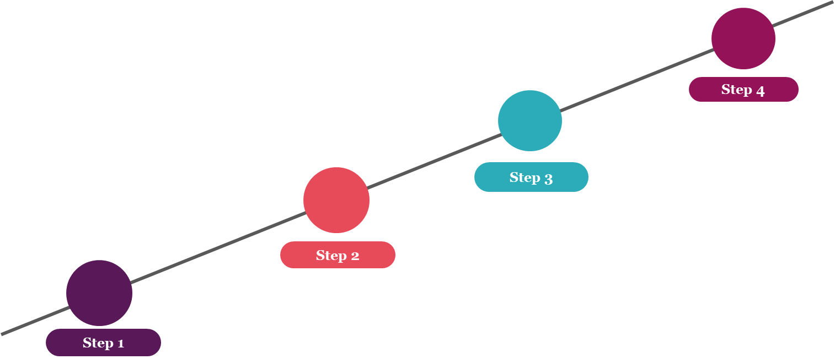


HARDWARE & PERIPHERALS
GPIO Interrupt: ensures accurate and responsive button presses.
UART (Serial Communication): sends data to caregiver.
RGB LED (Output): shows pain intensity visually.
Button (Input): increments pain level.

Slide 7
Issues & Obstacles We Faced
ISSUES | FIX
The board crashed on startup due to a Hard Fault. | Added a manual clock-enable routine (CLOCK_EnableClock(kCLOCK_PortA/C/E)) before calling any Assembly functions.
Every press kept adding up endlessly (1 → 2 → 3 → 4…). | Implemented a session-based input systemusing PIT interrupt. After 1.5 seconds of no presses → value is saved → counter resets.
SW2 (PTD11) interrupts were not firing because the pin floated and pull-ups were not configured, causing missed or repeated interrupts. | Configured PTD11 with an internal pull-up using PORT_SetPinConfig(), making interrupts reliable.
Button presses caused double or missed counts due to switch noise and fast interrupt handling. | Implemented a PIT timer as a debounce and multi-press window to accurately capture pain-level input.

Slide 8
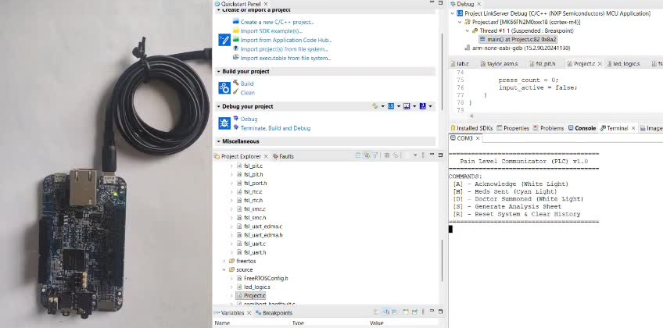
Prototype Demo

Slide 9
Thank you
Guiding You Toward a Life Beyond Pain.

